Slide 1
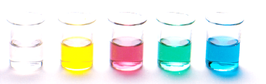
Molecular Shape and Polarity
Be able to apply VSEPR theory to predict molecular shape
Electronegativity and covalent bond dipoles
Polarity
Resources:
Pearson 12.1 and 12.2 incl. review sections
STAWA Set 18

Slide 2


Molecular shape
Valence Shell Electron Pair Repulsion Theory
Planar triangular
Tetrahedral
Trigonal pyramidal
Bent

Slide 3
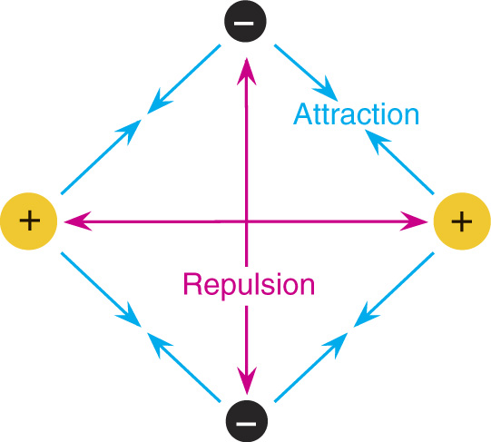
Molecular shape
VSEPR theory assumes that the shape of a molecule is determined by the repulsion of electron pairs.

Slide 4
VSEPR Theory
Based on Electron Dot (Lewis structures)
Theory predicts shapes of compounds
abbreviated VSEPR
VSEPR (pronounced “vesper”) stands for
Valence Shell Electron Pair Repulsion
VSEPR predicts shapes based on electron pairs repelling (in bonds or by themselves)
Electrons around central nucleus repel each other. So, structures have atoms maximally spread out

Slide 5
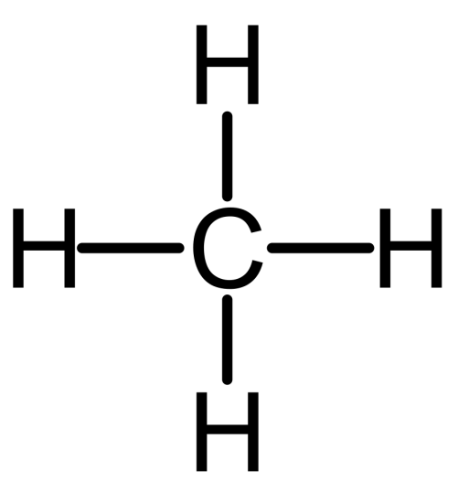
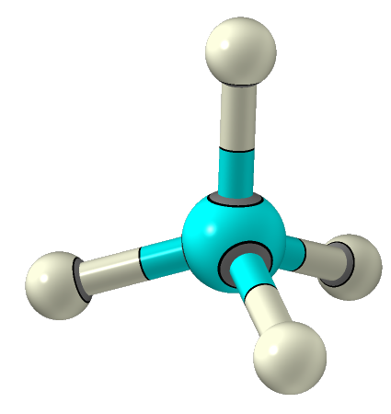
VSEPR Theory
methane, CH₄
Tetrahedral
109.5°
Bonds are all evenly spaced electrons

Slide 6
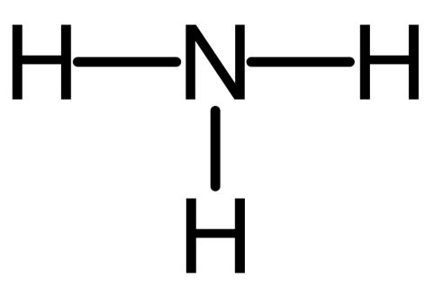
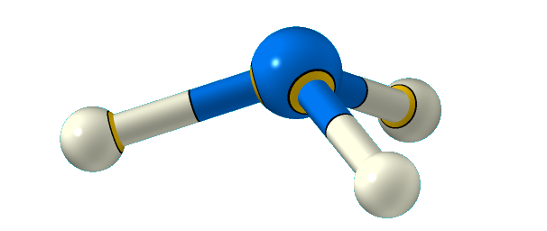
VSEPR Theory
..
ammonia
NH₃
Trigonal Pyramidal
Less repulsion between the bonding pairs of electrons

Slide 7
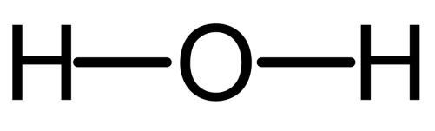
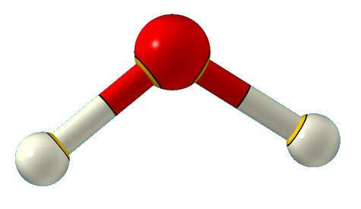
VSEPR Theory
109.5° (107°)
109.5° (104.5°)
109.5° (109.5°)

Slide 8
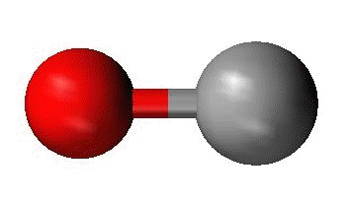
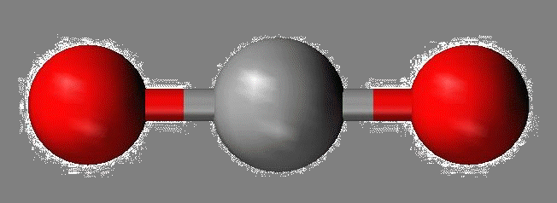
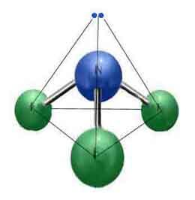
VSEPR Theory
Linear
Triangular Planar
Bent or V
Trigonal pyramidal
Tetrahedral

Slide 9
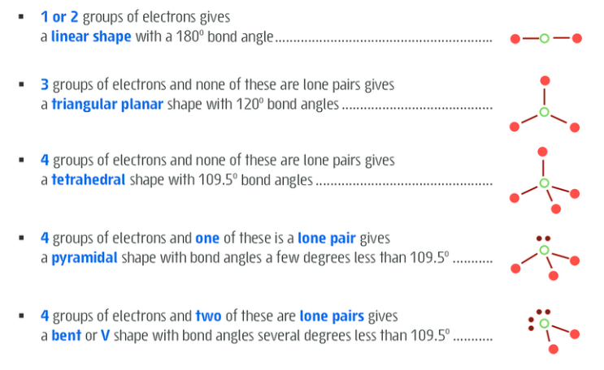
VSEPR Theory - summary

Slide 10
Electronegativity
Electronegativity measures the tendency of an atom to attract electrons
Ability of an atom in a molecule to attract electrons to itself
Measured on a scale of 0 to 4
On the periodic table, electronegativity increases left to right in a period and decreases down a group

Slide 11
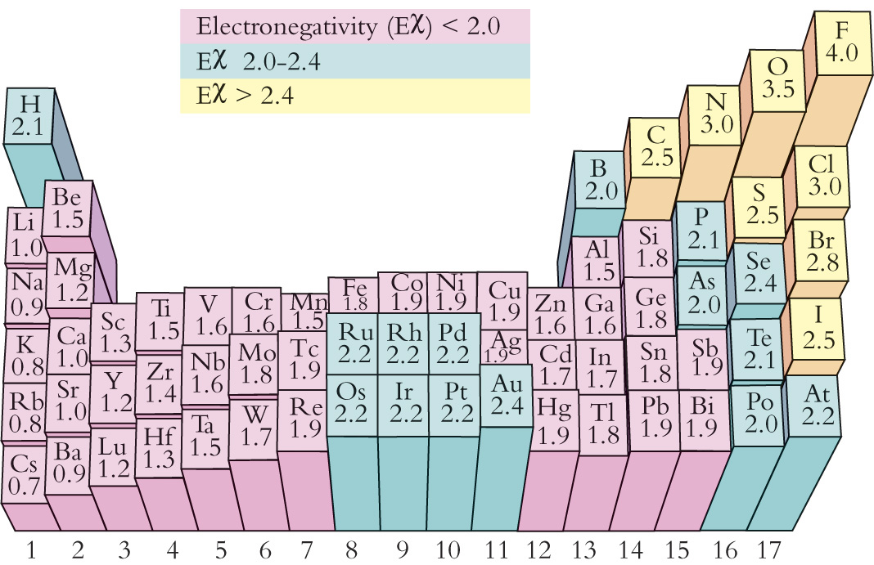

Slide 12
Electronegativity
Two atoms of different electronegativity form a covalent bond then an uneven sharing of the bonding electrons occur
As a result the more electronegative atom develops a small negative charge represented as δ⁻ (delta minus), the less electronegative atom develops a small positive charge δ⁺ (delta plus) – the covalent bond is said to be a bond dipole
2.1
Which atom attracts e⁻ more?
2.5
2.1
3.0
δ⁺
3.0
H
H ― Cl
δ⁻
C O
δ⁺
δ⁻
δ⁺
H

Slide 13
Covalent bond dipole
2.1
2.5
2.1
3.0
δ⁺
3.0
H
uneven
H ― Cl
δ⁻
C O
δ⁺
δ⁻
δ⁺
H
3.0
2.5
3.0
even
O
C O
Zero net dipole

Slide 14

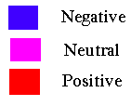

Polarity
POLAR MOLECULES = uneven distribution of charge.
one side of molecule is slightly negative ; one side is slightly positive. * Creating poles
NON-POLAR MOLECULES = no difference in charge on outside of molecule.
Electrons are evenly distributed. Uniform charge on outside of molecule.

Slide 15
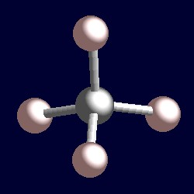
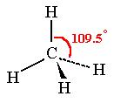
Polarity
Predict the polarity of CH₄ (methane)
Step 1: Determine polarity of bonds
C-H bond is not a dipole bond
Step 2: Determine polarity of molecule
If bonds making up a molecule are non-polar, then the molecule is non-polar.
Therefore, CH₄ is a non-polar molecule.

Slide 16
Polarity
Carbon dioxide
Step 1: Determine polarity of bonds
Which atom attracts electrons more?
δ⁻
δ⁺
δ⁺
δ⁻
O
C O
O = e⁻ pulled toward
Step 2: Determine polarity of Molecule
shape is linear – so the dipoles are equal and symmetrical, therefore no net dipole
If bonds making up a molecule are polar, then the molecule may be polar or non-polar, depending on its shape.

Slide 17
Polarity
Sulfur dioxide
Step 1: Determine polarity of bonds
δ⁺
Which atom attracts electrons more?
S
O
O
δ⁻
δ⁻
Step 2: Determine polarity of Molecule
shape is bent – so the dipoles are equal but unsymmetrical, therefore there is a net dipole

Slide 18
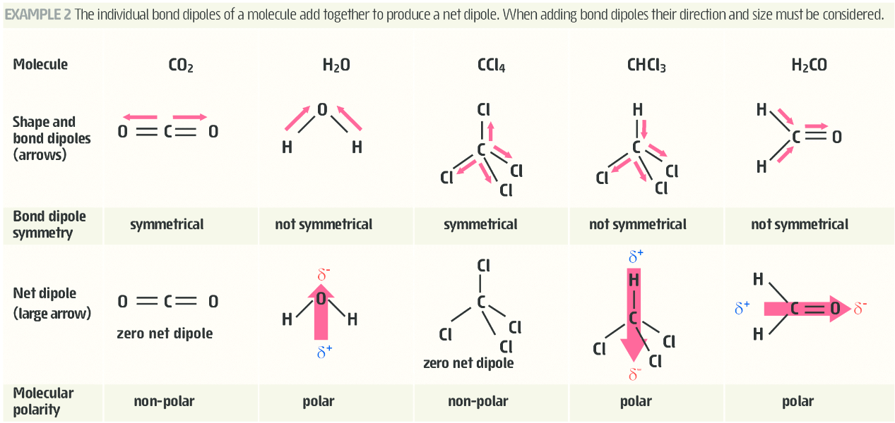
Polarity

Slide 19
On going work
Complete Pearson review sections for 12.1 and 12.2
STAWA set 18

